Slide 1

Analysing dataset cars24 using SQL
~Simran Dhingra

Slide 2
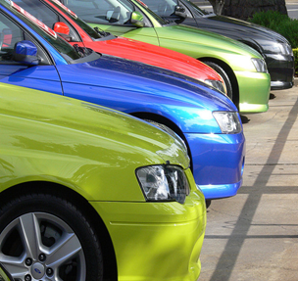
Analysing cars24 dataset
We have been provided with cars24 dataset that we are using to gather top 10 insights by leveraging SQL which will help the company in taking future business decisions.

Slide 3
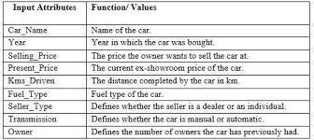
Dataset overview
dataset contains used car data along with car model , having the price which user is selling along with year of release of the car during it was introduced in the market.
Following are the key columns -
Name
Year
Selling_price
Km_driven
Owner

Slide 4
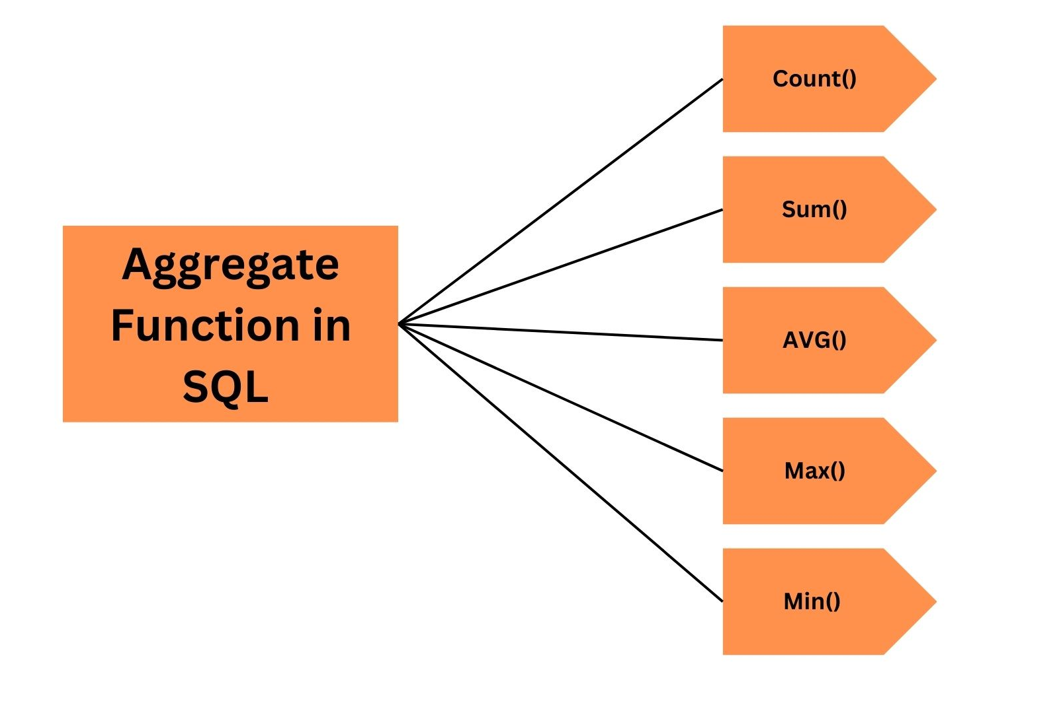
Methodology
SQL Aggregate Functions
Sum: this aggregate function is used to calculate aggregate sum of a given column, and provided that the given column should of numeric supported data types of SQL (for example : INT, BIGINT, FLOAT)
Avg: this aggregate function is used to calculate aggregate average of a given column, and provided that the given column should of numeric supported data types of SQL (for example : INT, BIGINT, FLOAT)

Slide 5
Max and Min: these aggregate function is used to calculate aggregate maximum and minimum of a given column, and provided that the given column should of numeric supported data types of SQL (for example : INT, BIGINT, FLOAT)
Count: this aggregate function is used to calculate aggregate count of a given column, and provided that the given column should of numeric supported data types of SQL (for example : INT, BIGINT, FLOAT)

Slide 6
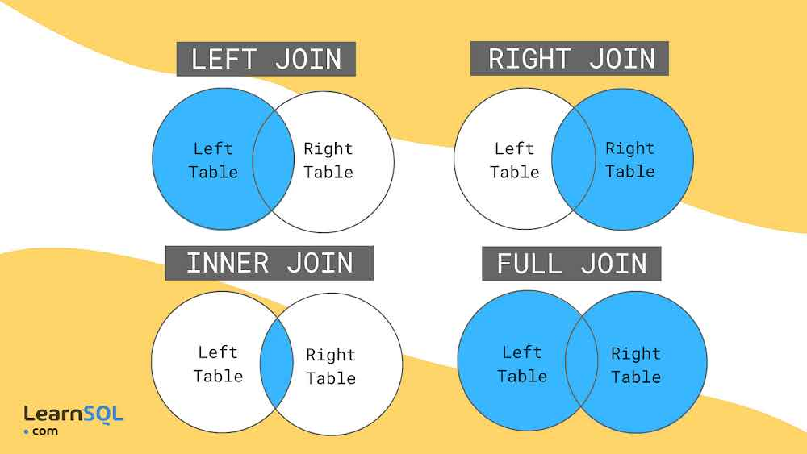
SQL joining data
Inner Join:
~Returns only the rows that have matching values in both tables being joined.
~ Excludes rows where there is no match found.
~ Useful for retrieving data that exists in both tables.
Left Join:
~Returns all the rows from the left table, and the matched rows from the right table.
~If no matching rows exist in the right table, it returns NULL values for the columns from the right table.
~Useful for retrieving all records from the left table, with matching records from the right table.
Right Join:
- Returns all the rows from the right table, and the matched rows from the left table.
- If no matching rows exist in the left table, it returns NULL values for the columns from the left table.
- Less commonly used than left join but provides similar functionality, just with the tables switched.

Slide 7
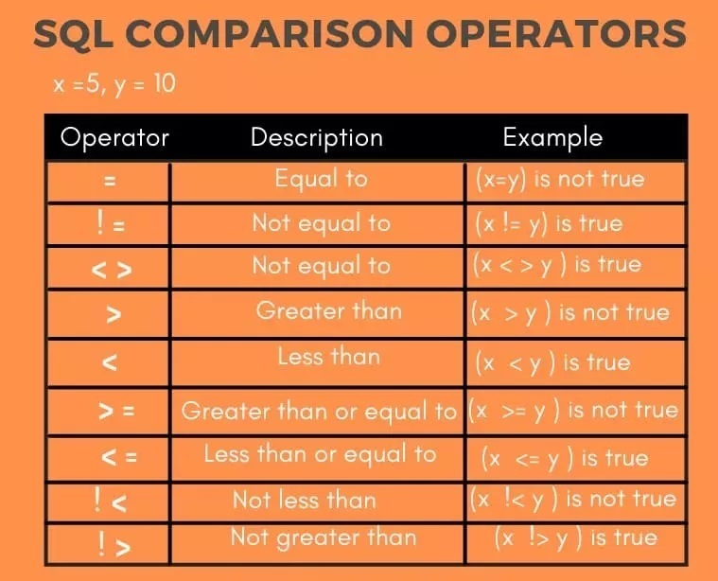
SQL Operators
IN
~ The IN operator allows you to specify multiple values in a WHERE clause.
~ It is used to determine if a value matches any value in a list or a subquery.
~ It's particularly useful when you want to compare a value against multiple
possible values.
= (Equal to):
~ The = operator is used to compare two values to check if they are equal.
~ It's commonly used in WHERE clauses to filter rows based on exact matches.
< (Less than):
~The < operator is used to compare two values to check if the left operand is less than the right operand.
~It's useful for filtering rows where a particular column's value is less than a specified value.

Slide 8
> (Greater than):
~ The > operator is used to compare two values to check if the left operand is greater than the right operand.
~ Like <, it's often used in WHERE clauses to filter rows based on values that exceed a certain threshold.
LIKE:
~The LIKE operator is used in a WHERE clause to search for a specified pattern in a column.
~ It allows for pattern matching using wildcard characters such as % (matches any sequence of characters) and _ (matches any single character).
~ Useful for finding rows where values match a certain pattern, such as searching for names starting with "Joh" or ending with "son".

Slide 9

Queries explanation
~IN 2012, how many total cars are sold?
select count(*) from cars24
where year = 2012;
(By using this query , like we can fetch the data, only In 2012, how many cars are sold)
~Range between 500000 to 1000000, what cars are present in this range an asc order?
select * from cars24
where selling_price between 500000 and 1000000
order by selling_price;
(By using this query , we can find that data which cars range is only 500000 to 1000000)

Slide 10
~Get all the cars whose seat more than 5.
select * from cars24
where seats>5;
(By using this query,you will get all the cars whose seat is more than 5)
~Top 3 cars that was sold in all the cars?
select top 3 CAST(NAME AS NVARCHAR(MAX)) AS car_name,count(*) AS cnt from cars24
group by CAST(NAME AS NVARCHAR(MAX))
order by cnt desc;
(By using this query, we can fetch only 3 cars which is top in all the cars)
~Get all the cars whose cars has been driven at most 20000 kms, IN the desc order which cars has been driven?
select * from cars24
where km_driven<20000
order by km_driven DESC;
(By using this query, we can fetch the cars whose km_driven is at most 20000 kms)

Slide 11
~Get me all the cars whose selling price is greater the average selling price of all the available cars?
select* from cars24
where selling_price>(select avg(cast(selling_price as bigint)) from cars24);
(By using this query,you can find how many cars which we have whose selling price is greater than average.)
~Fetch all the cars name which is owned by first owner?
select * from cars24
where owner LIKE 'First Owner';
(By using this query , we will get only first owner of the cars)
~Total cars whose fuel name is petrol?
select * from cars24
where fuel like ‘petrol';
(By using this query, we can get all the petrol cars)
~Find all the cars whose name start with given input string?
select * from cars24
where name like 'mar%';
(By using this query, we will find how many cars which is staring name is ‘MAR’)

Slide 12
~Divide the cars into Entry level, Mid level, premium level for the following ranges
between 500000-1000000
between 1000000-50000000
more than 50000000
SELECT *,CASE
WHEN selling_price BETWEEN 500000 AND 1000000 THEN 'Entry level'
WHEN selling_price BETWEEN 1000000 AND 50000000 THEN 'MID level'
WHEN selling_price > 50000000 THEN 'Premium level'
else 'others'
end as 'levels'from cars24
order by selling_price;
(By using this query, we can fetch that cars first whose price selling price is between 500000 to 100000,Second , we can find selling price between 100000 to 5000000, and then more 5000000. in single query by using case we can give more conditions.)
~Find 5 cars with the highest mileage in desc order?
select top 5 * from cars24
order by mileage desc;
(By using this query, we can find top 5 with the highest mileage of the cars)

Slide 13

Conclusion
Sales by year: Businesses can determine the number of cars sold in that particular year. This information helps in assessing annual performance.
Annual Sales Trends: Businesses can use queries to analyze sales data for each year, allowing them to track sales performance over time. Identifying patterns and trends in annual sales can help businesses make informed decisions and plan strategies accordingly.
Top-Selling Cars: By querying sales data based on selling prices, businesses can identify which car models are the most popular and have generated the highest revenue. This information is crucial for inventory management, marketing strategies, and forecasting future sales.

Slide 14

Future Work
Innovation and Differentiation: we will introduce new features, upgrades, and exclusive offerings to enhance the appeal of our top-selling cars.
Targeted Marketing: Leveraging data-driven insights, we will devise targeted marketing campaigns to effectively reach our discerning clientele, highlighting the unique value propositions of our flagship models.
Cultivating Customer Relationships: Building upon our reputation for excellence, we will prioritize customer satisfaction and loyalty, fostering long-term relationships through exceptional service and personalized experiences.

